Slide 1
Welcome Back
Lucian Lockhart Elementary
2021-2022

Slide 2
School Hours
7:15 AM Doors Open
7:30 AM Classes Begin
7:40 AM Tardy
9:15 AM Official Attendance
3:00 PM Dismissal

Slide 3
Student Hours
First Day of School August 23, 2021
Student Hours 7:30-3:00

Slide 4
2021-2022 Academic Calendar

Slide 5
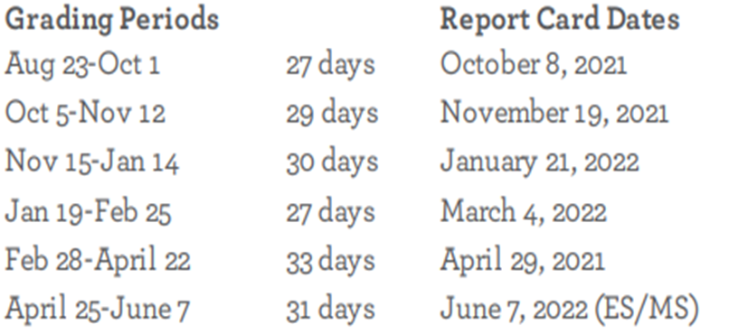
Grades
There are no plans for grade exceptions.
All students must meet the corresponding criteria to earn a passing grade on assignments and classwork.
All grades will count towards a student passing a course/grade.

Slide 6
Assessment Calendar
Students will be administered various standardized test throughout the school year, depending on their grade level. Assessment dates will be noted on the monthly calendar. Teachers will also provide information regarding assessment dates. Please ensure that your student eats a healthy breakfast either at school or before arriving to school and that they get plenty of rest.

Slide 7
HB 4545
4th and 5th grade students who did not pass their STAAR test during the 2020-2021 school year will receive 30 additional hours of intervention during the 2021-2022 school year.
Students who did not take the test will take the HB 4545 BOY to determine if they will need additional intervention.
Intervention may be provided during the school day, after school, and on Saturday.
Parents will receive detailed information regarding their student’s STAAR scores and intervention schedule.

Slide 8
Attendance
Attendance is taken DAILY
Classes Begin at 7:30 AM
Official tardies are at 7:40 AM
Official ADA time is 9:15 AM
No early departures after 2:15 PM

Slide 9
Communication
Please use Parent Connect to check grades daily
Teachers will communicate via Class Dojo, email, monthly newsletter, and information located in the Thursday Folder
You will receive campus updates via School Messenger, monthly calendars, and information located in the Thursday Folder
You may also check the campus website and social media pages for updates:
Lockhart ES Website: http://www.houstonisd.org/lockhartes
Lockhart Twitter: @lockhartES

Slide 10
Temporary Online Learning
Student's temporary medical condition is documented by a licensed U.S. physican. Documentation must include a physician's statement directing the student to remain at home or in a hospital.
Student has a postive COVID-19 test or is displaying symptoms of a recognized communicable disease.
Student has been identified as having been in close contact with an individual with a confirmed or presumed positive case of COVID-19.

Slide 11
Medical Needs
Medication
Allergies
Immunizations

Slide 12
Student Mask
Students who do not have a mask will be provided with one.
Students who refuse to wear a mask will be places in a separate area and their parent/caregiver will be contacted.
Students who continue to refuse to wear a mask will be directed to stay home and be marked as absent. However, they will be offered temporary online learning.

Slide 13
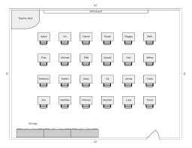
Physical Distancing
Assigned seating will be required in all classrooms and cafeteria.
Water fountains will be available as refilling stations only.
Bottled water will be provided for students during lunch.

Slide 14
School Uniform
Orange, White, or Navy polo-style shirt with blue pants/skirts.
Lockhart Spirit or Club Shirt with jeans (no rips, no holes) – on Friday and designated Dollar Days

Slide 15
Food of Minimal Nutritional Value
The following food items may not be given to elementary school students during the school day:
Soda: Any carbonated beverage
Water ices: Any frozen, sweetened water such as popsicles
Chewing gum
All candy
Candy coated popcorn
If your student brings their lunch to school, please adhere to these guidelines.

Slide 16
Student Dismissal
Be sure to establish a routine that your child understands. If changes must be made, communicate those to your child before they arrive to school.
Any changes to the regular routine should be communicated in writing and sent to the classroom teacher.

Slide 17
Restricted Visitors
Only necessary visitors will be allowed on campus.
Appointments must be made 24 hours ahead of time.
Visitors are required to wear a mask.

Slide 18
VIPS
Volunteers In Public Schools
http://houstonisd.org/vipslogin

Slide 19
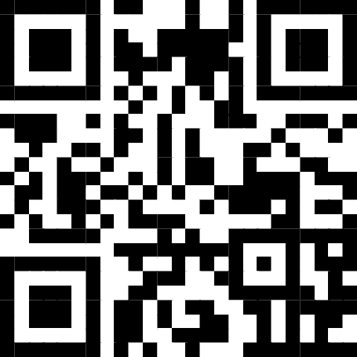
Virtual Open House
September 9, 2021
3:30 pm – 5:00 p.m.
https://tinyurl.com/vu94dbzn

Slide 20
Other Important Dates
September 6, 2021: No School
September 14, 2021: Parent University
September 14 – 23, 2021: Book Fair
September 16, 2021: No School
September 23, 2021: High Frequency Word/Literacy Program
September 28, 2021: Coffee with the Principal
** More detailed information regarding Lockhart ES policy and procedures can be found in the student/Parent Handbook and HISD’s Code of Conduct. You will also find information in the Ready, Set, Go! Parent Guide. Documents are located in the parent section of our school website.

